Slide 1
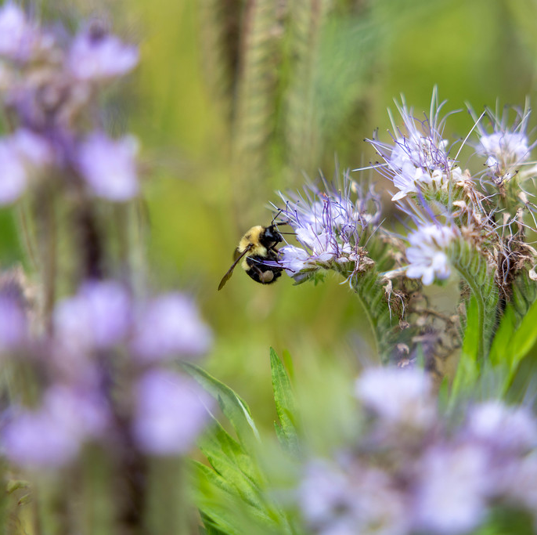
Town of Perinton
2026 Community Garden Season
Garden Coordinator – Mackenzie Zerniak
gardencoord@perinton.gov
(585) 223-5050

Slide 2
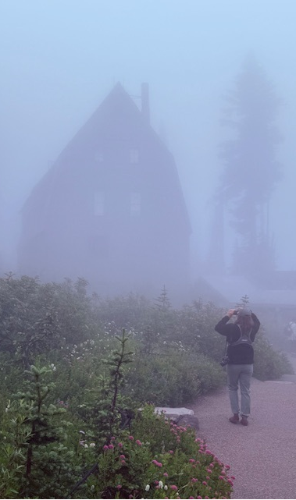
Community Garden Coordinator - Mackenzie
4th season as garden coordinator
Availability
  Wednesday, Thursday, Friday
    Winter hours 7am – 3:30pm (Fridays 2:30pm)
    Summer hours 6am - 4:30pm (Fridays 2:30pm)
  Contact by email or phone
Natural Resource Conservation & Plant Based Chef
Birding, Hiking, Traveling

Slide 3
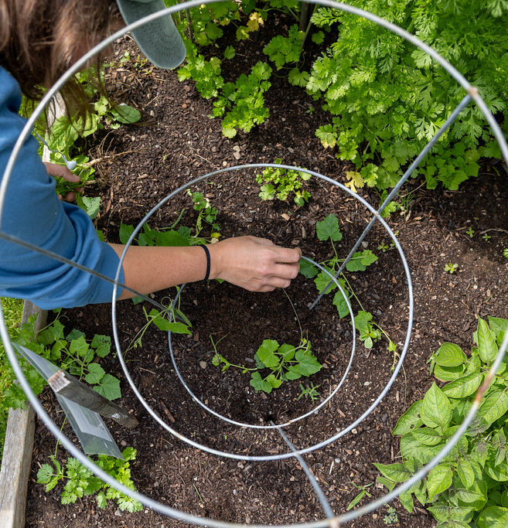
Garden Member Responsibility
Regularly maintain garden plots - planting, weeding, watering, harvesting and winterizing.
Give a minimum of a two (2) week notice if you are unable to tend to your plot and would like coverage
Plots can be used to grow food, flowers and herbs.
Organic methods of gardening are to be followed.
Organic garden waste should be brought to the green organic waste totes located in the garden.
Keep tool shed orderly; cleaning tools before returning them to proper places
Read through the handbook for additional information pertaining to guidelines of the community garden
You agree to only plant, harvest and water the plot(s) assigned to you. Theft will not be tolerated.
*Please request permission from the community garden coordinator to plant in vertical or community gardens.
Notes:
May 1st – October 16th – main growing season
Water & Harvest signs now available if going away
Going away but need assistance – 2 week notice for coverage

Slide 4
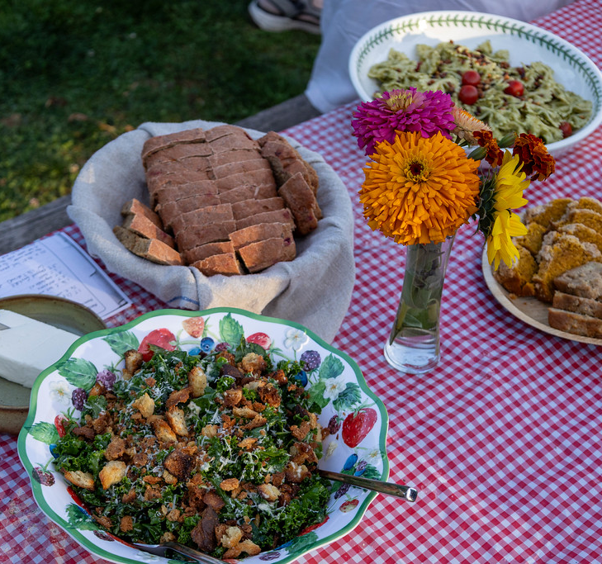
Community Garden Basics
Organic compost outside the gate near tool shed
Community Garden Core
Community garden workdays & events
  Communications binder
Donations
Save plastic pots and trays
Community garden webpage
NEW – U-pick flower beds
Notes:
Will try to keep the compost stocked outside the tool shed – Vermigreen in Palmyra, NY – certified organic
Core members have vouched to volunteer 15 hours of time throughout the season
Garden workdays and events will be sent via email for folks to sign up
Events calendar in communications section of binder
Information regarding upcoming event with more details
Donations – Weigh, record, label
Delivered by volunteers
Store in mini fridge / in basket on top of fridge
Food and Flower donations to evergreen east / community garden stand (will be located at the CC)
Always seeking recycling containers such as plastic bags, clamshells, glass jars
Community garden webpage
Resources
Seeds / transplants
Gardening books
Planting information
Guides that could be helpful
FAQ
Seed Saving Project
Handbook/Map

Slide 5
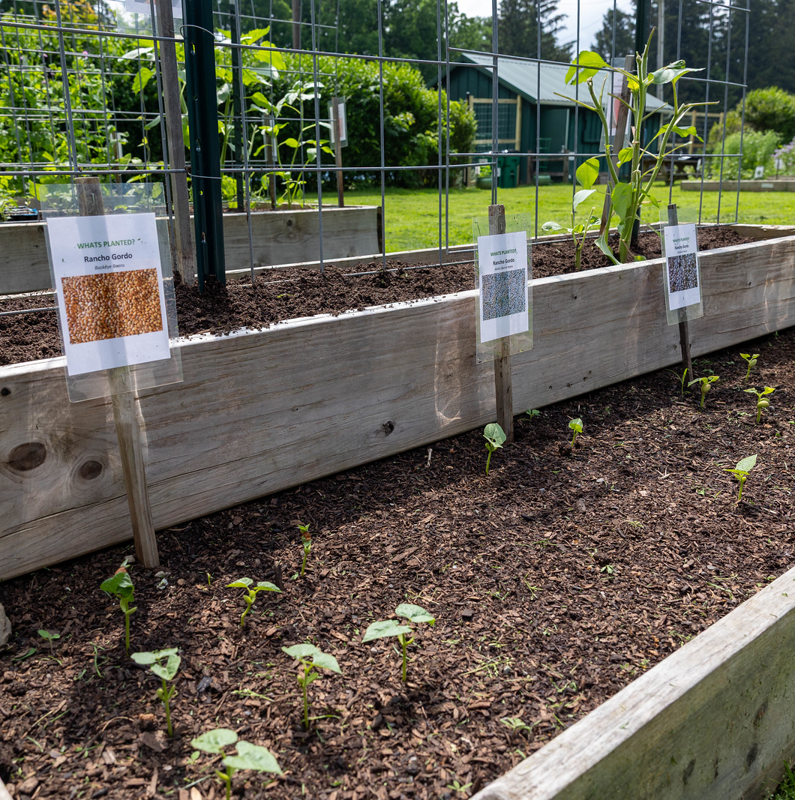
Projects and Goals
Food Donations – 275lbs of food to nourish the community
Repair and replace damaged garden boxes
Create additional garden plots
Beautify the fence
AARP Grant
Notes:
2 donation locations
Evergreen East
Community Garden stand – will be located at the community center
AARP Grant – waiting to hear back
Replace Vertical Garden Beds
Replace Community Beds
ADA Raised Beds
New picnic tables and benches
Change layout of garden…

Slide 6
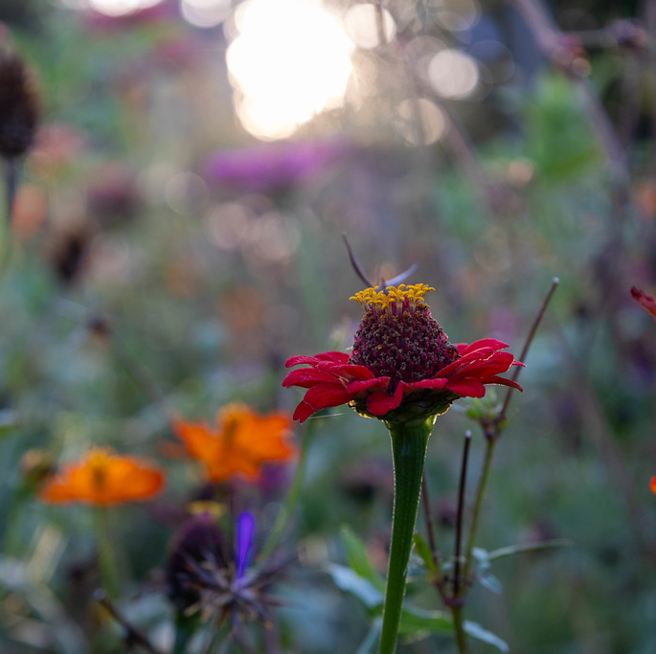
From 2025…

Slide 7
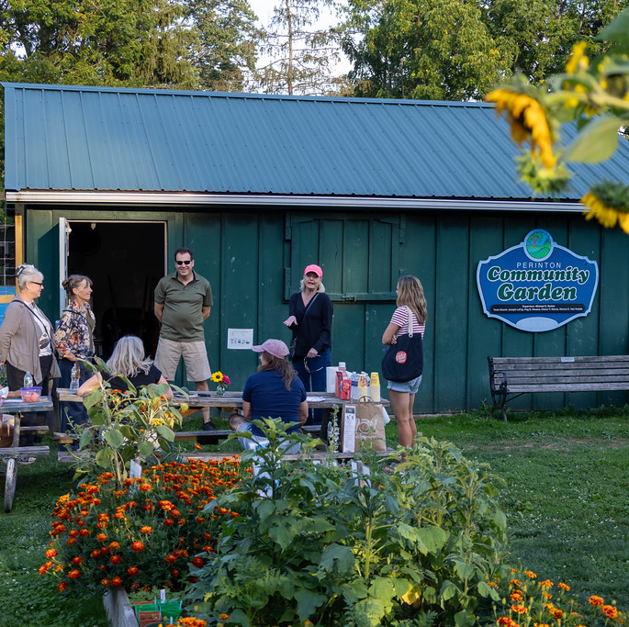
Community Garden Members
55 members in 2025
13 new members (24%)
42 members from 2024 (76%)
10 core members, 5 additional volunteers contributing over 80 hours of volunteer hours

Slide 8
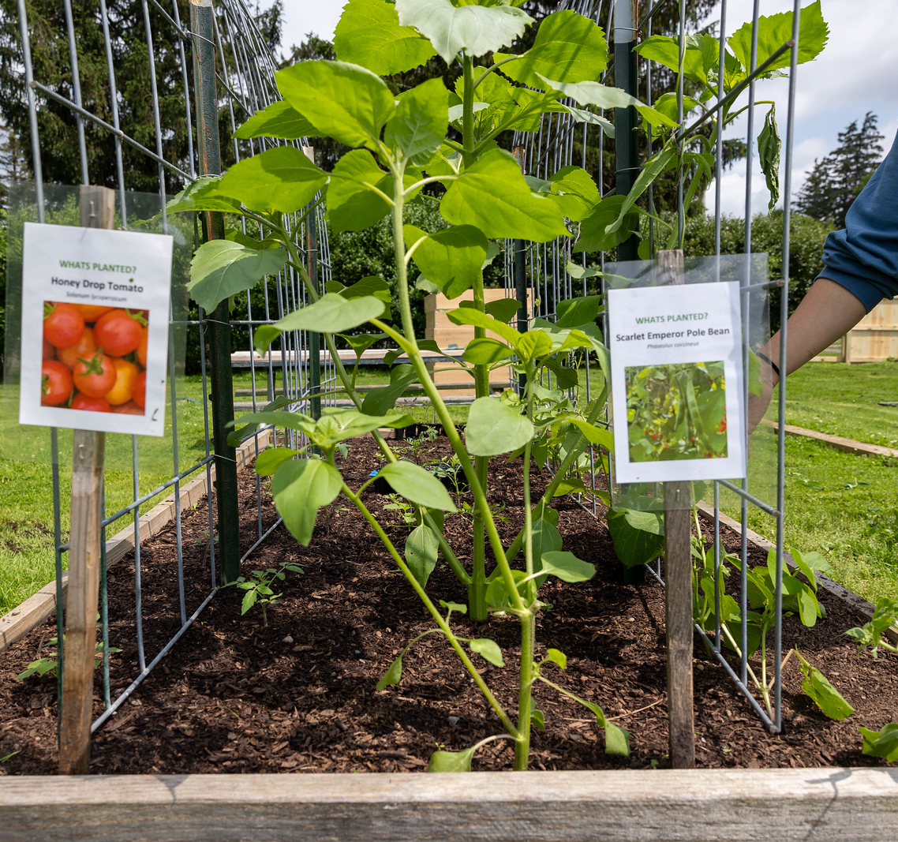
Donations
338lbs of food donated to the community
Top 3 donations
  Tomatoes
  Zucchini
  Beets
Donations to Evergreen East and Community Garden Stand

Slide 9
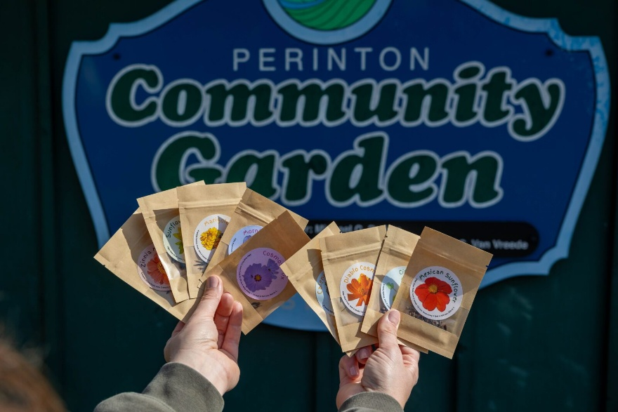
Seed Saving Project
Started in 2024 with seed collection
14 seed varieties
1,328 packages of seeds distributed in 2025
39,000 seeds
18 varieties of seeds saved in 2025 for 2026

Slide 10
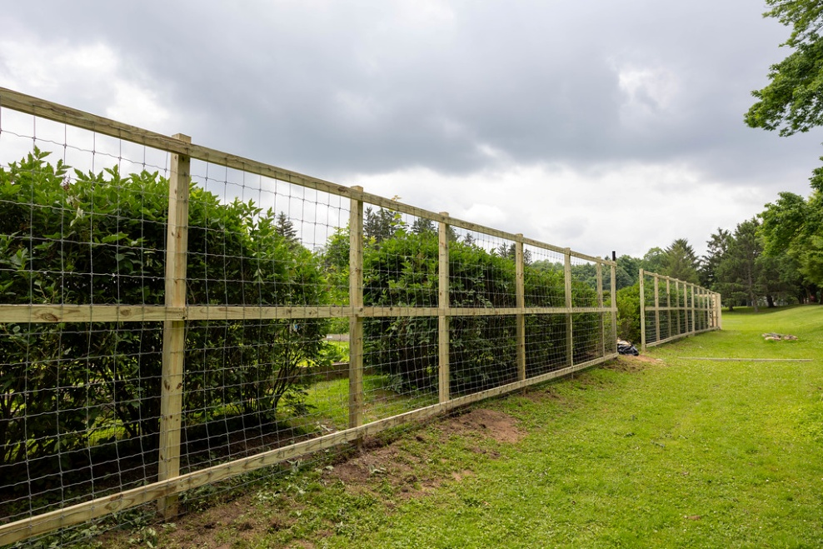
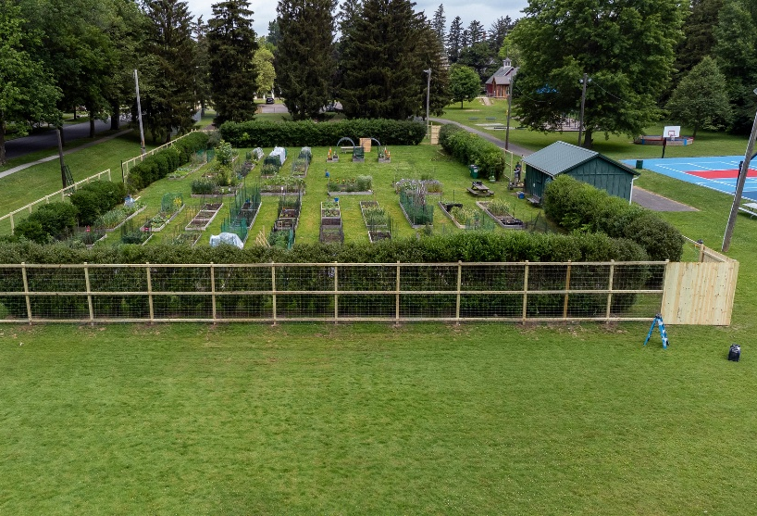
Perimeter Fence
8-foot tall
Woven wire
Fully enclosed community garden

Slide 11
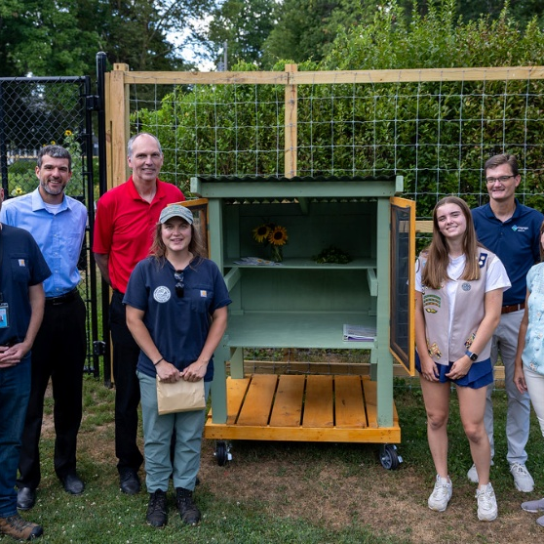
Community Garden Food Stand
Girl Scout Gold Award Project

Slide 12
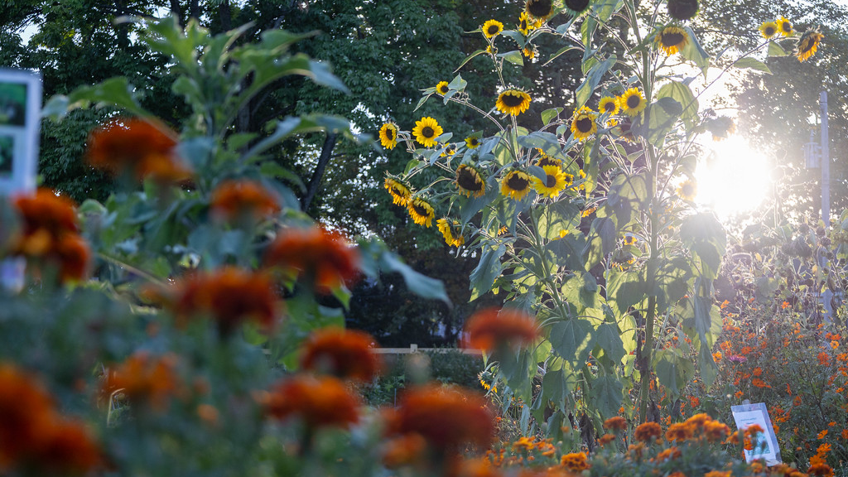
Questions or Comments

